Slide 1
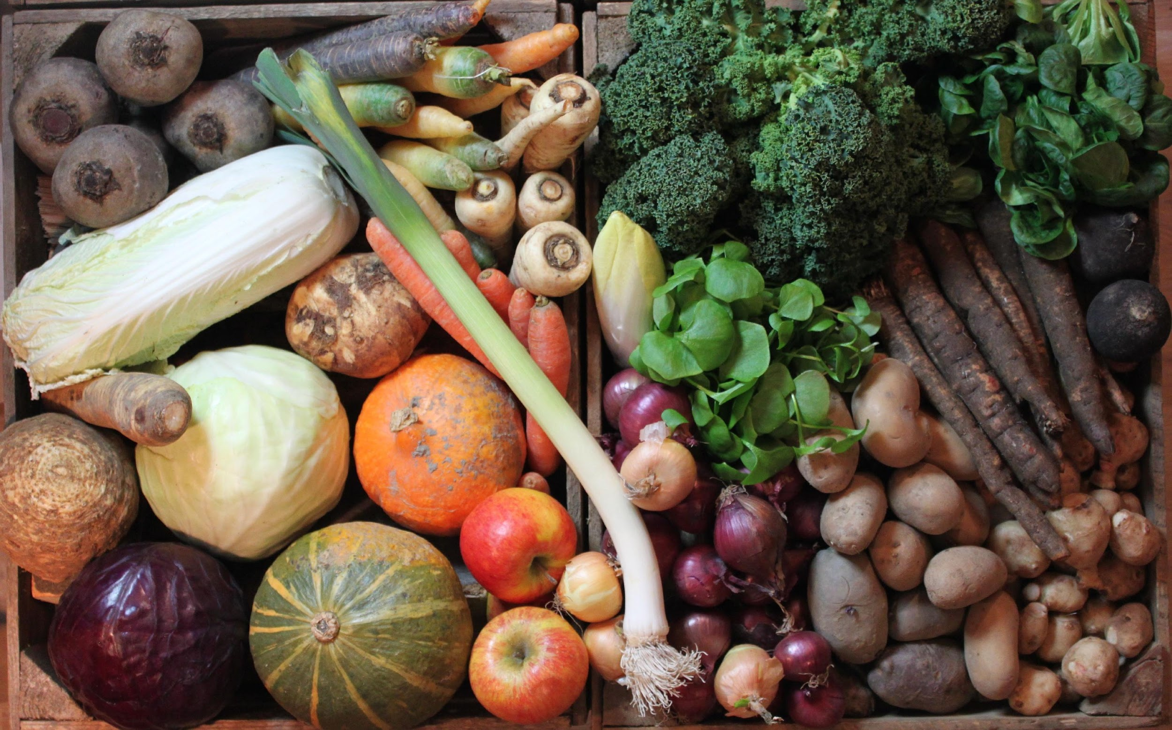
Herkimer County Adirondack Food Access Study
2022
Mari Kate Mycek, PhD
Funded by Herkimer County and The Community Foundation of Herkimer and Oneida County

Slide 2
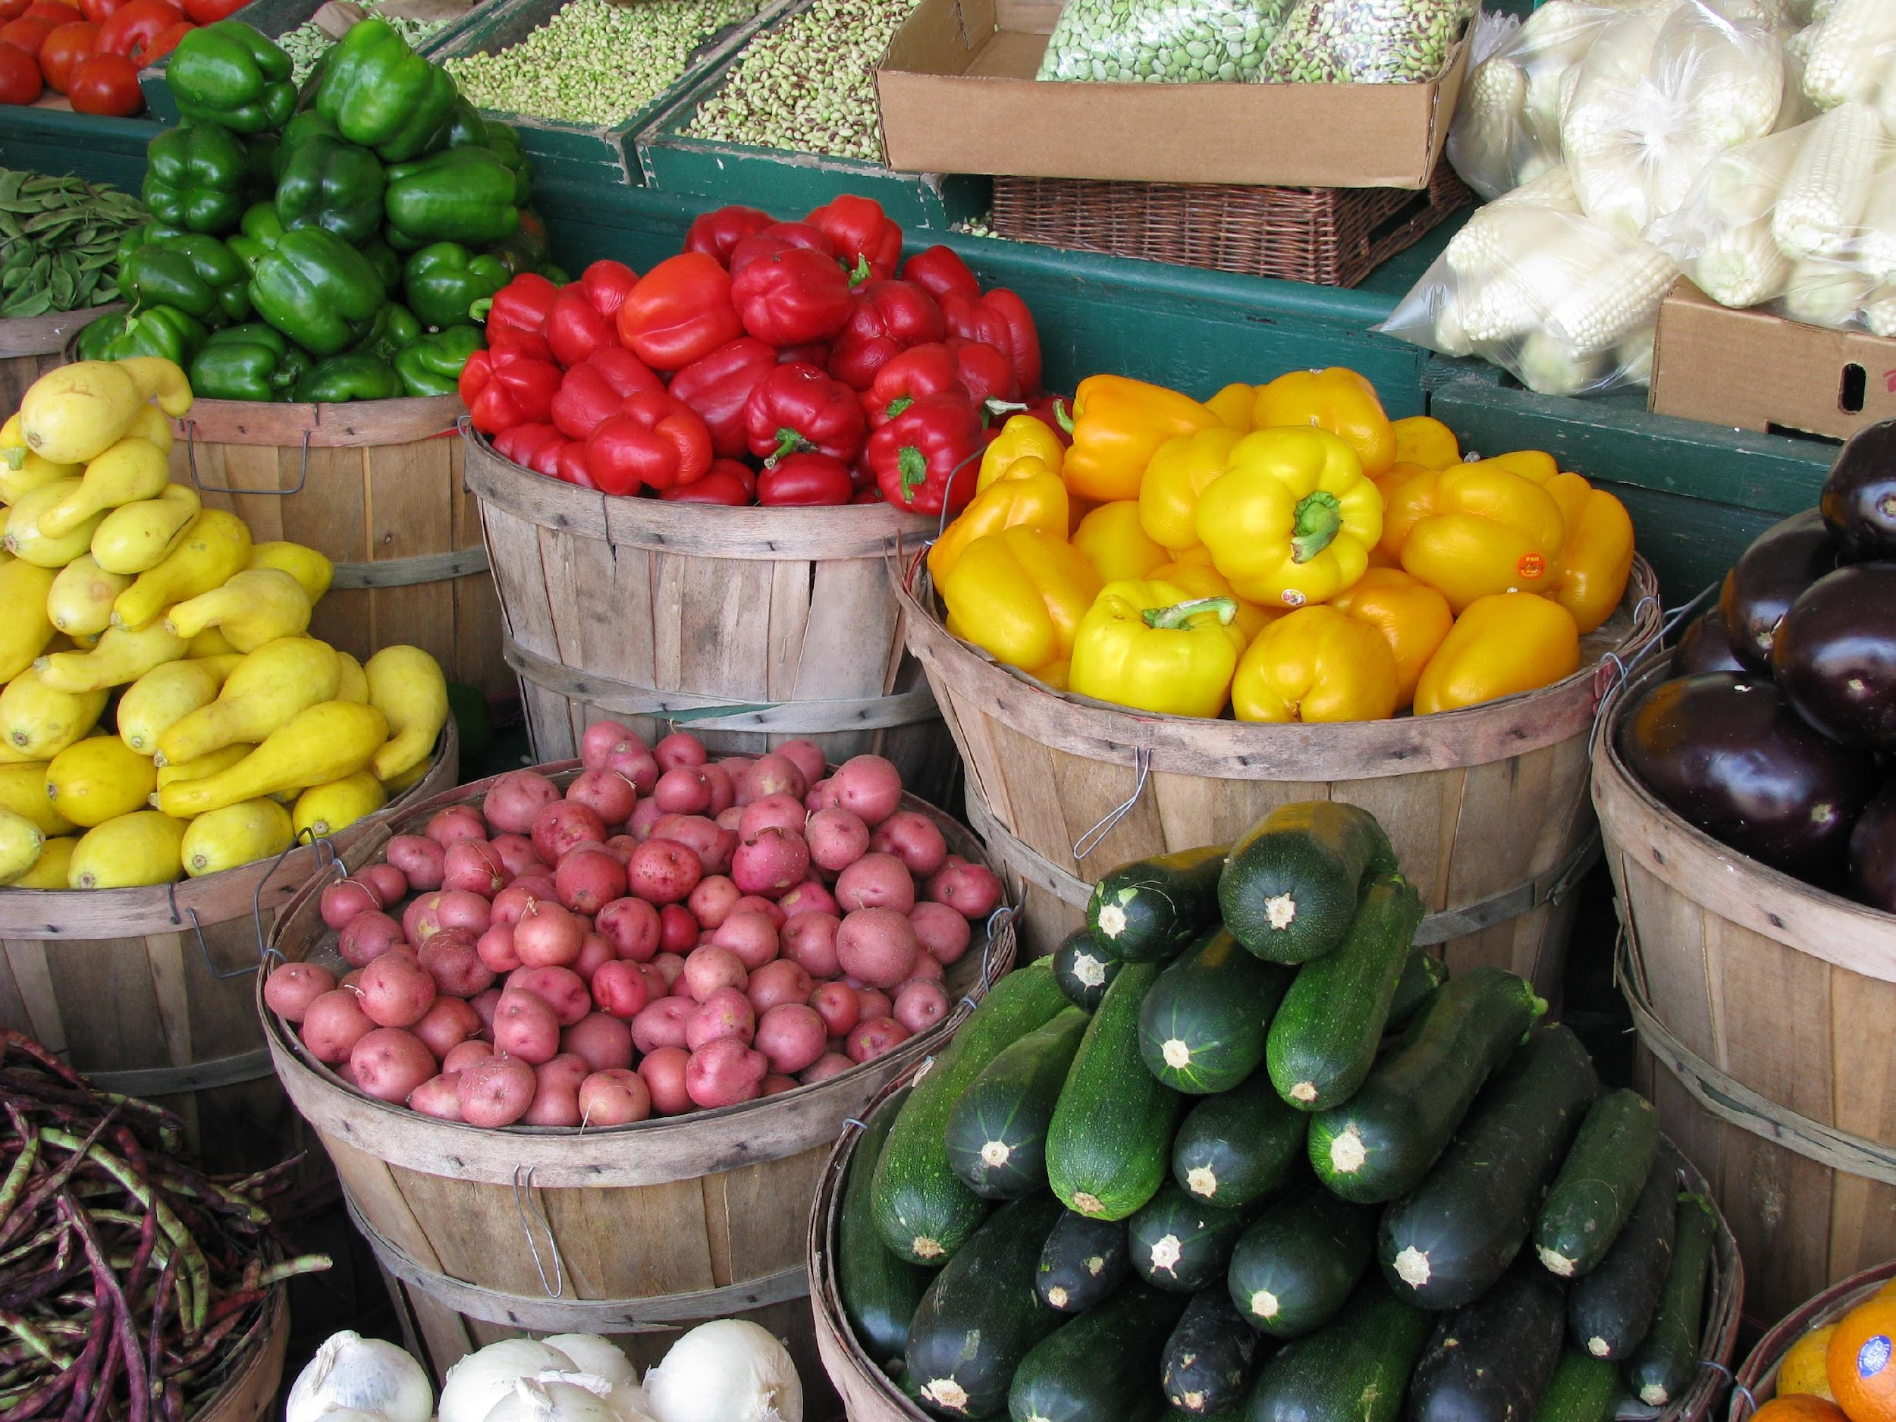
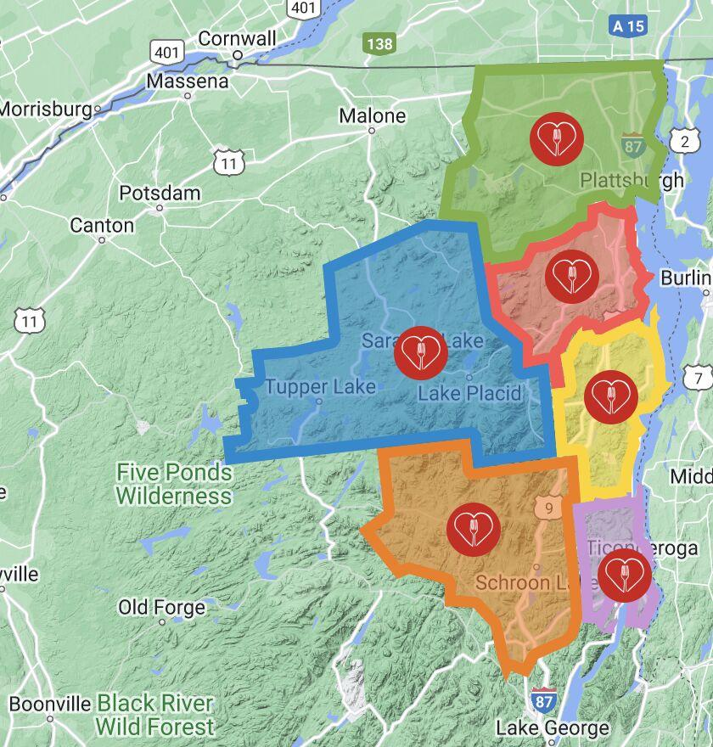
Introduction
Access to fresh, healthy, local food = thriving, happy communities
ADK Park has historically low food security and access
Western ADK portion of park is siloed and left behind
CCE Herkimer County, Herkimer County, and LivingADK, conducted community-based research to understand existing food access in this “left out” region

Slide 3
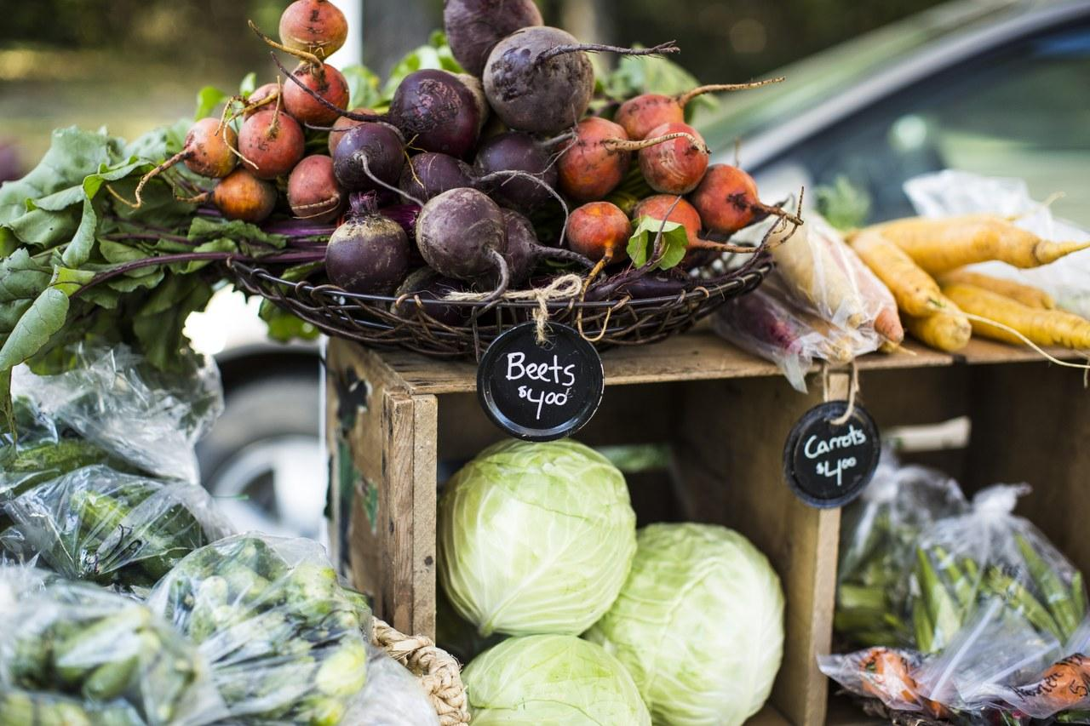
Research Question and Goals
What are the food sources that people are accessing in this Central Adirondack Regional Corridor (CARC) region?
What barriers do residents face in obtaining the food they need to live healthy, happy lives?
Is there an effective local solution that we can help promote to address some of this?
How can we strengthen local supply chains to increase access (by partnering with Mohawk Valley producers, farmers, and other organizations throughout the Adirondack Region working on similar initiatives)?

Slide 4
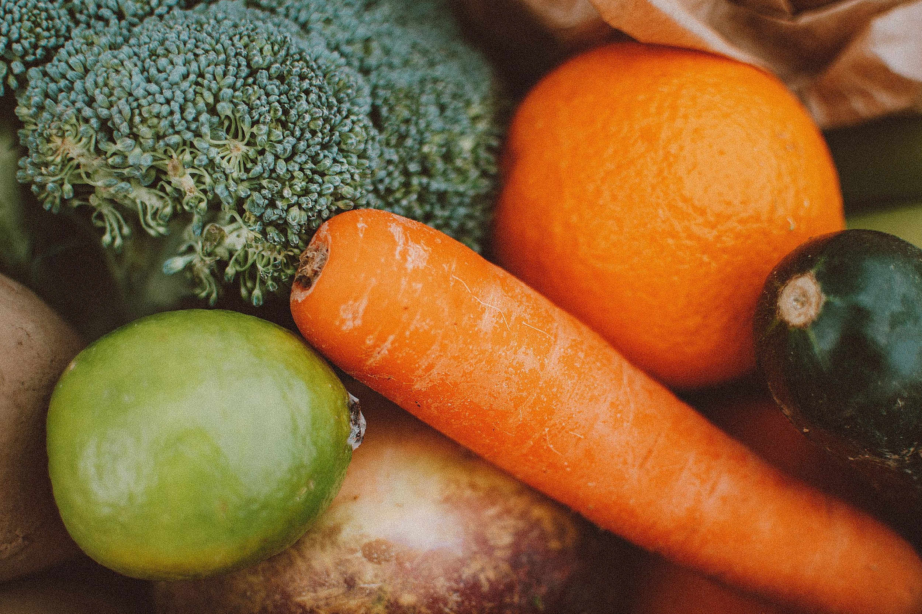
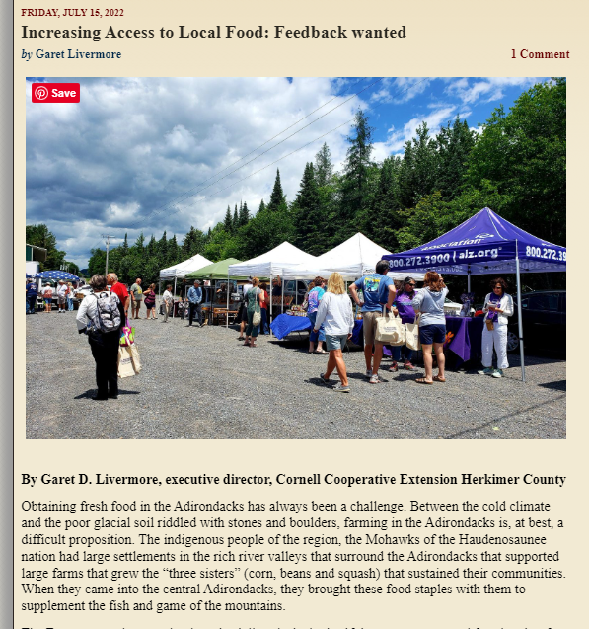
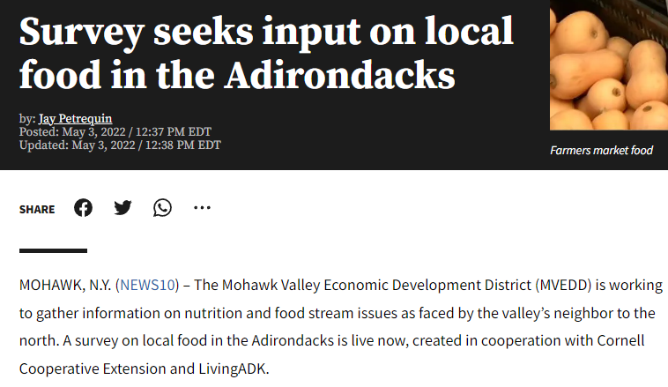
Data Collection
Resident Survey
Participant Observation
Interviews

Slide 5
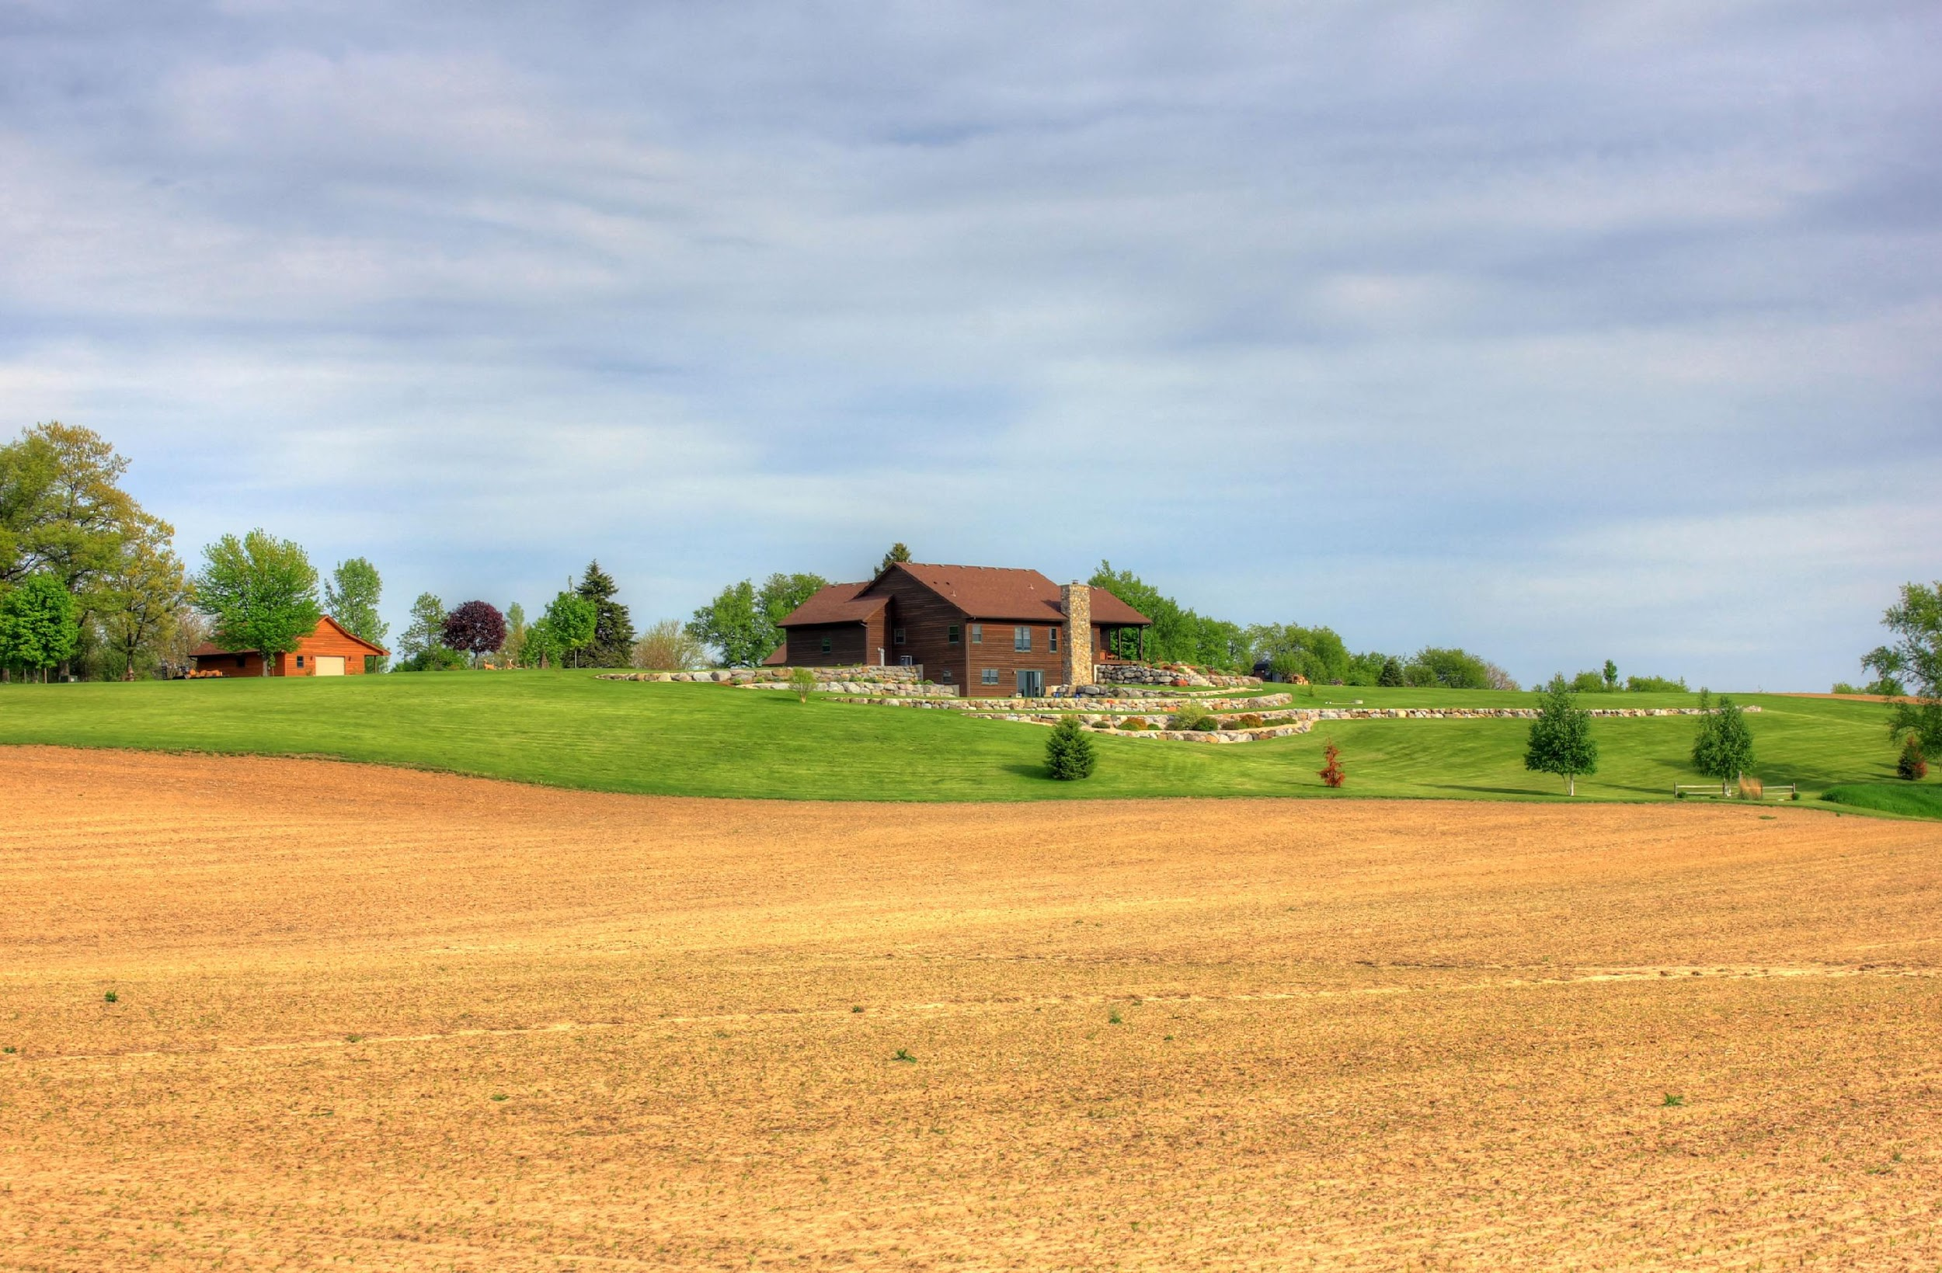
Survey Findings
Launched April 2022 – October 2022
Promoted locally and online
We received 101 responses to the survey. After quality control, seven responses were removed because they did not meet the study criteria, leaving a total sample of 94 responses.

Slide 6
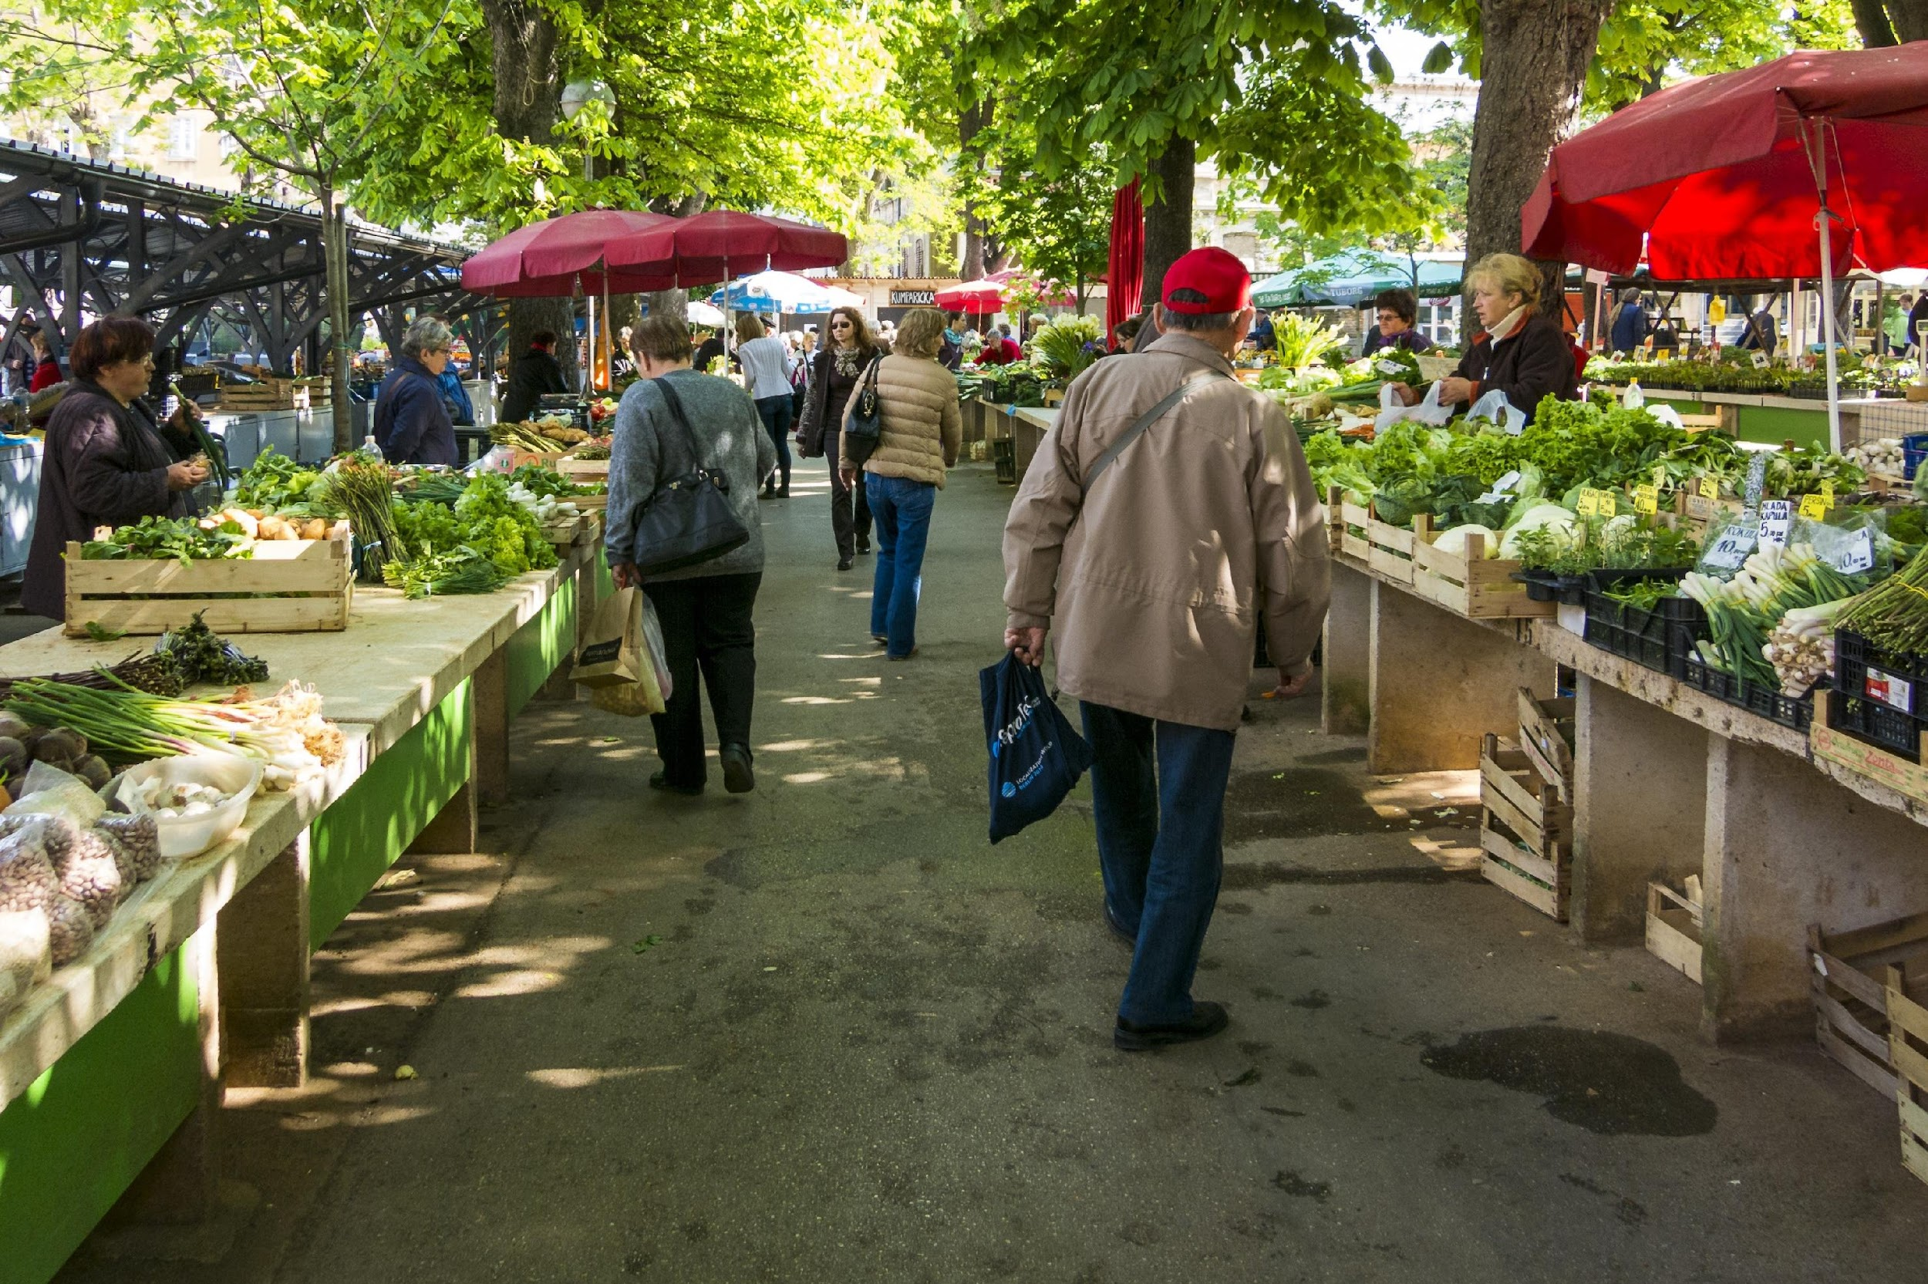
Survey Respondents - Who are they?
Most of the respondents were yearlong residents (N=62), which was our goal, given that we were most interested in how residents navigate foodways all year.
Most of the respondent’s were women (N=73)
Wide range of yearly income
More older than younger participants (>56, N=58)

Slide 7
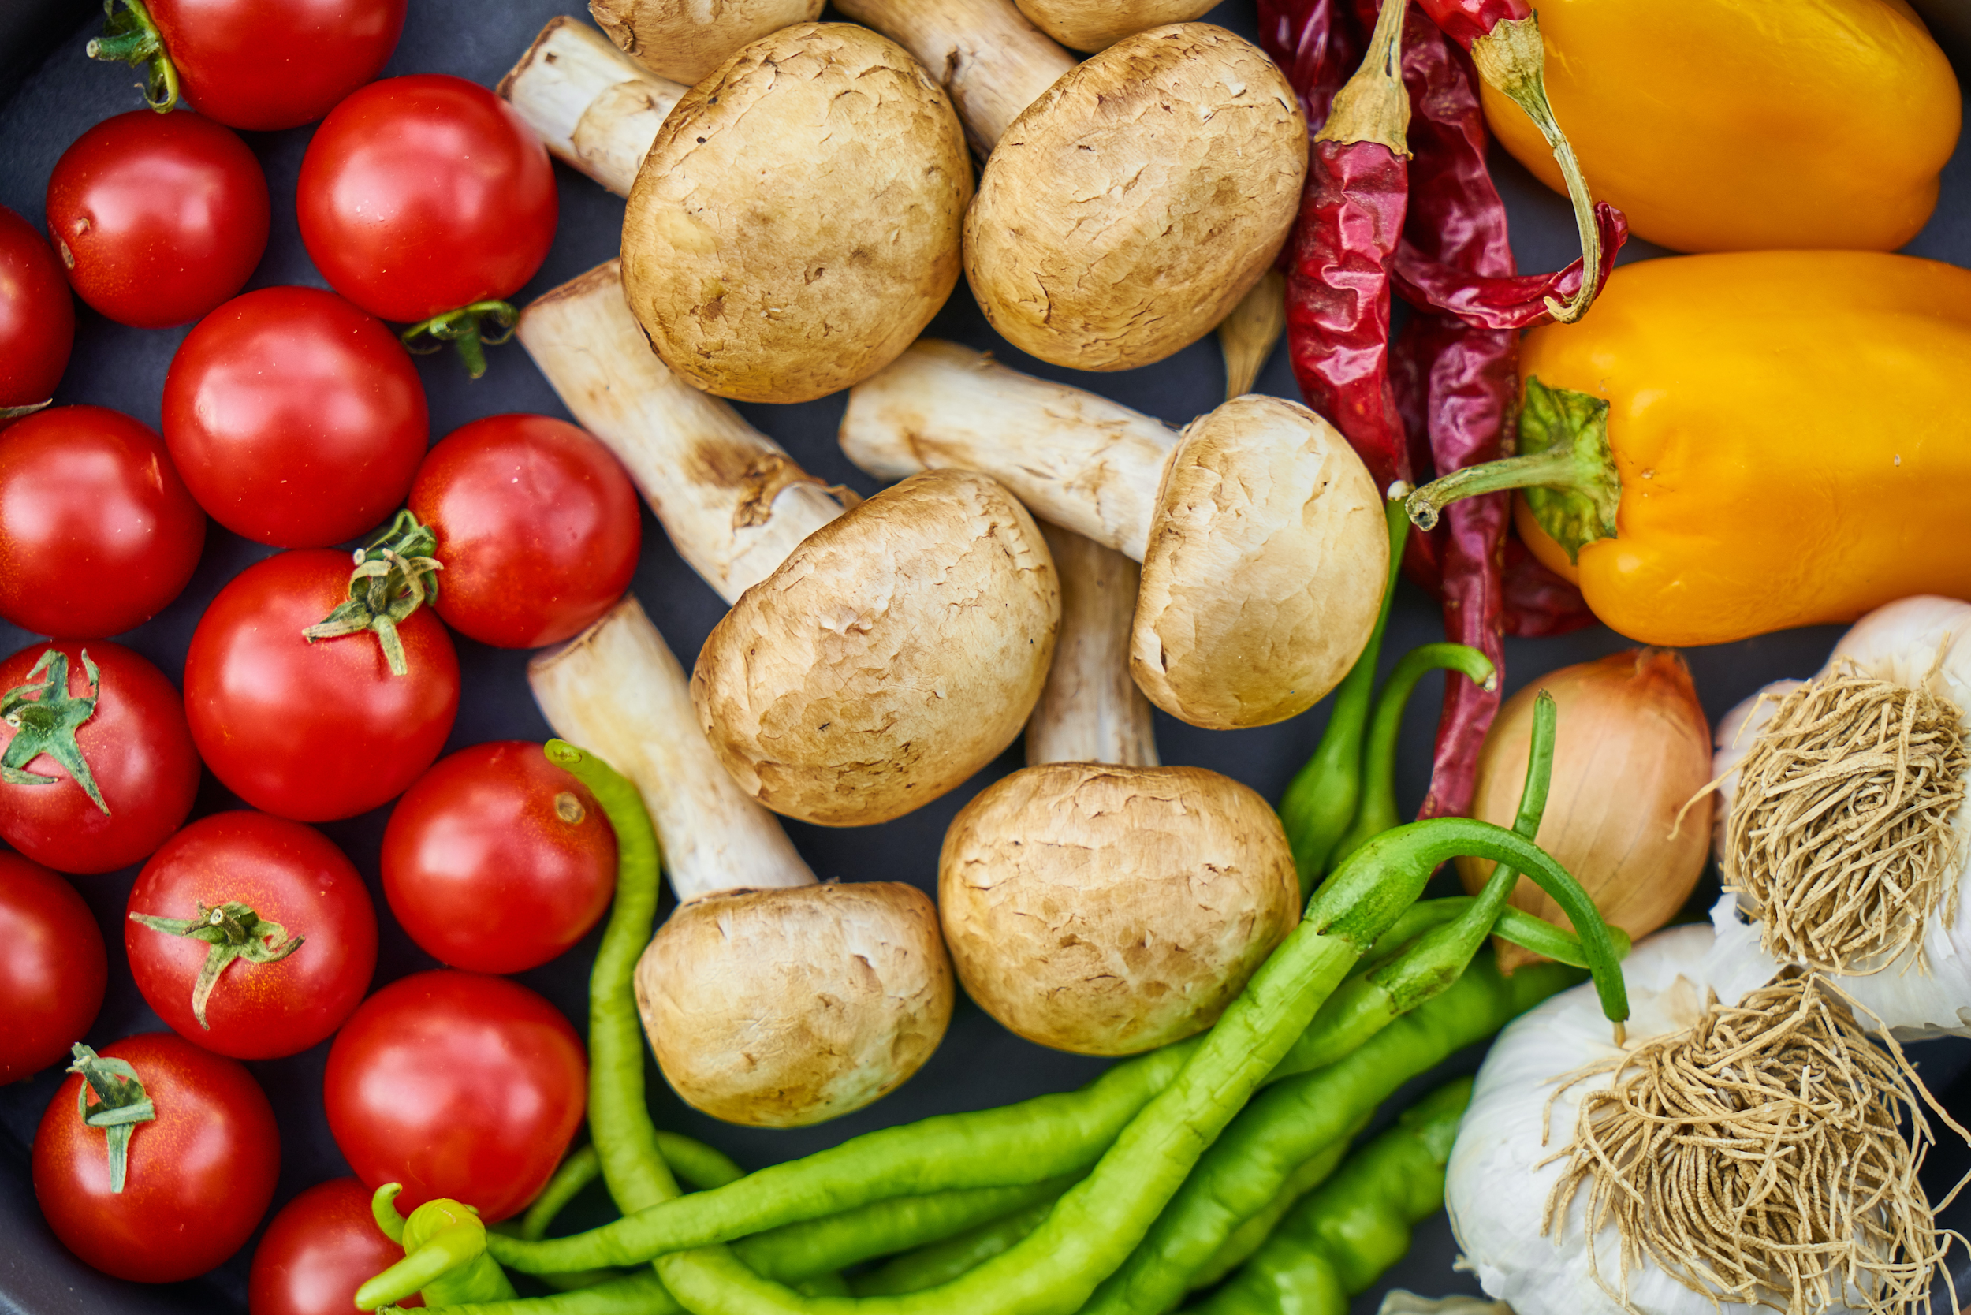
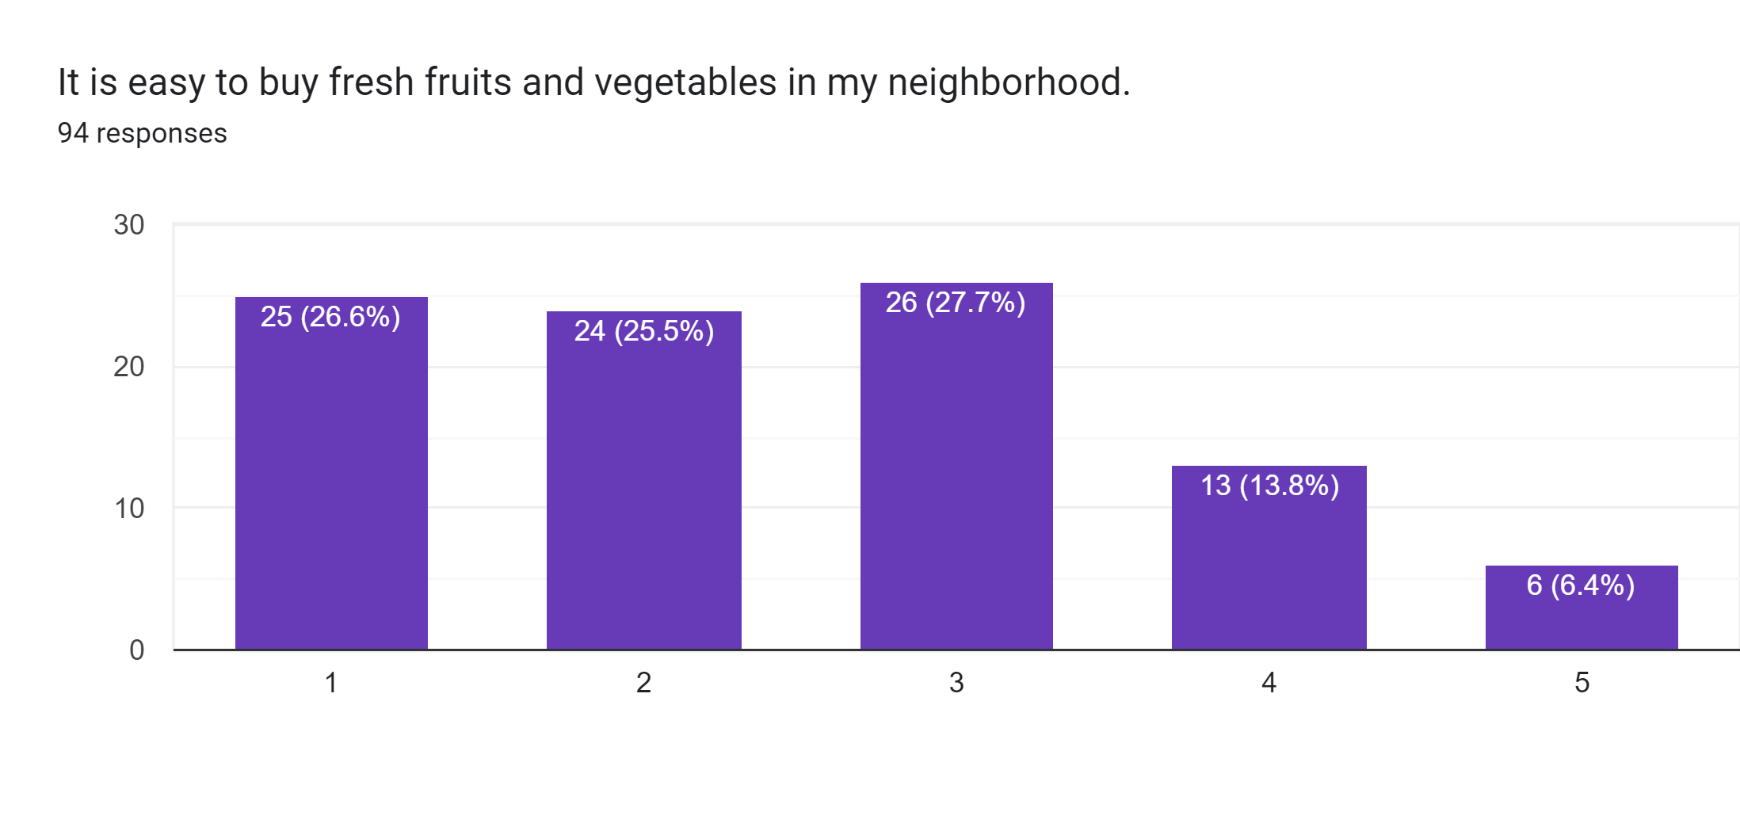
Survey Findings
1 – Strongly Disagree 5 – Strongly Agree

Slide 8
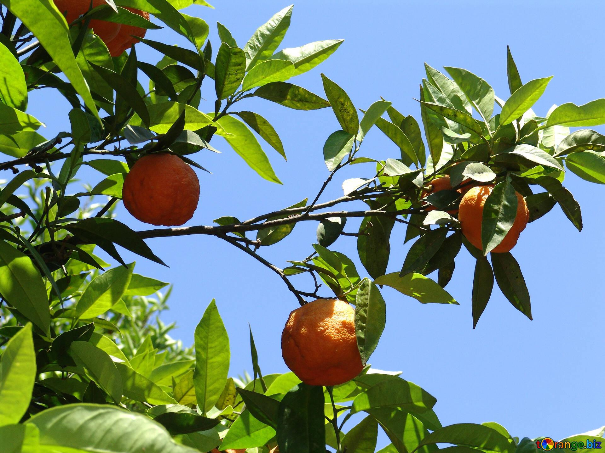
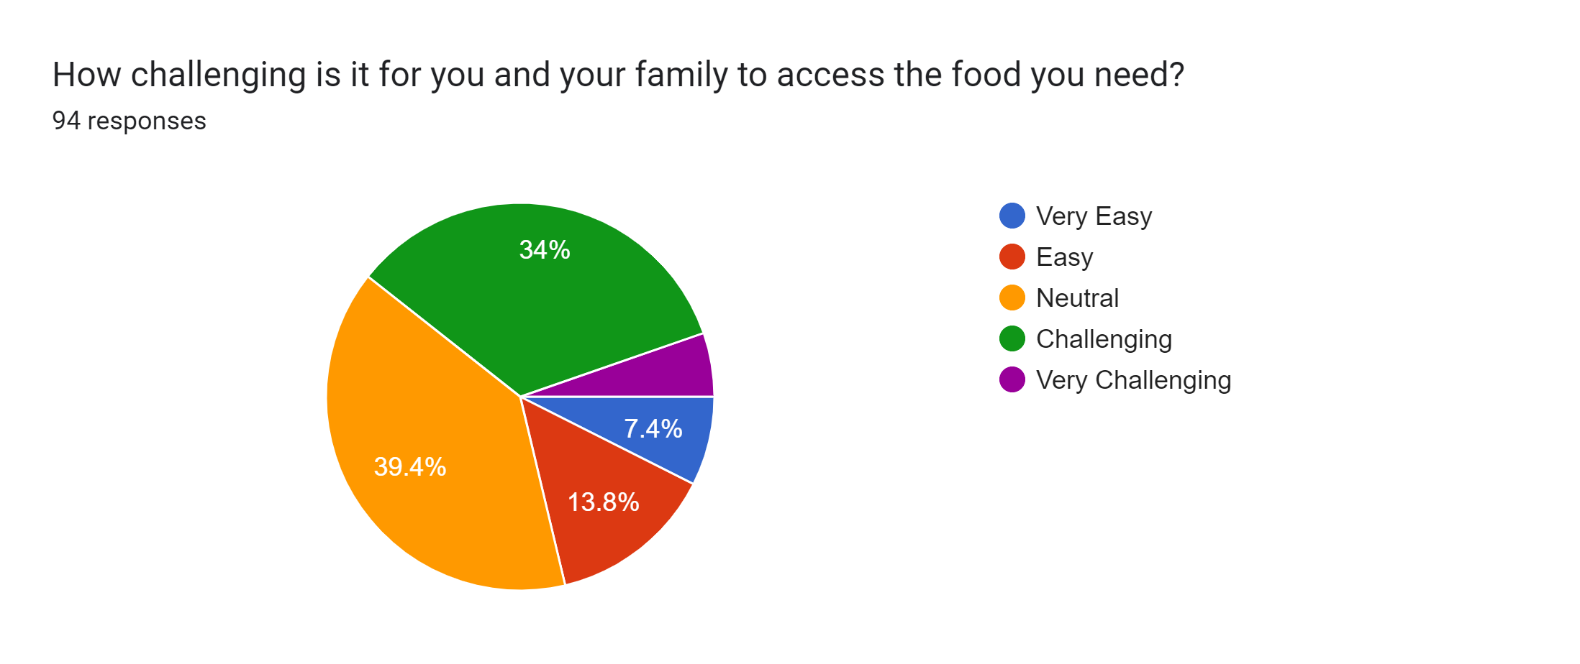
Survey Findings
- Only 21% thought it was easy or very easy
- The percent of the sample that answered challenging is much higher than state and national averages

Slide 9
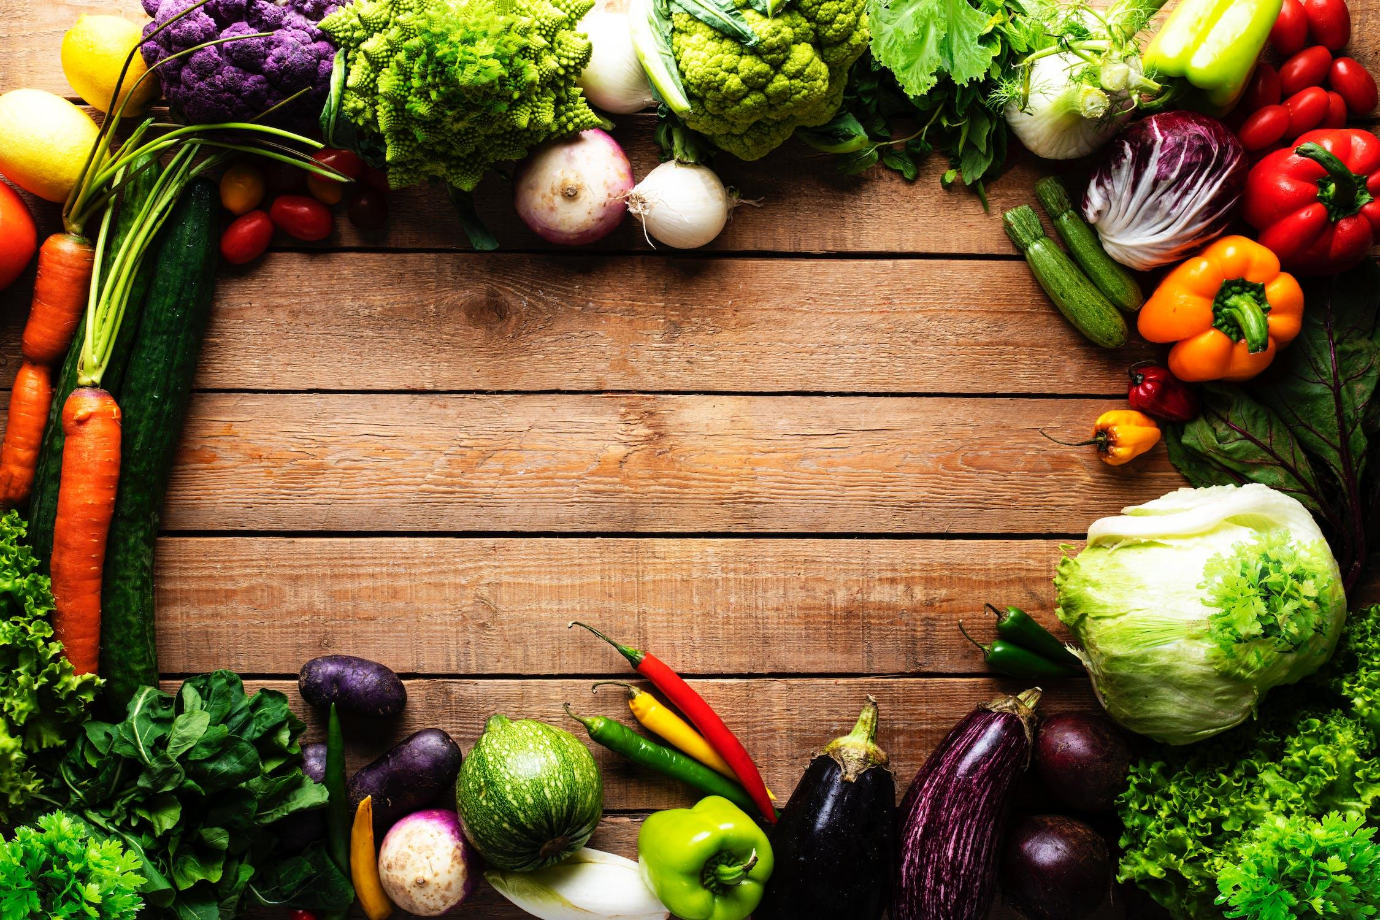
Barriers to Access
Respondents income was not a significant predictor of reporting challenges to food access (price alone is not the problem)
Seasonality is much more of a factor when it comes to residents' ability to access food. Whereas seasonal residents had an average of “neutral” for the question, regarding challenging to food access, year long residents were decidedly negative, indicating an average of “challenging.”
Residents deeper into the park on average report feeling more challenged, with the most residents indicating challenges in Long Lake.
 | size | mean
Are you a yearlong/all year resident?
No | 32 | 0.000000
Yes | 62 | -0.241935

Slide 10
Barriers to Access
We asked participants how easy or challenging it was for them to access the foods their family needed, in their own words.
The responses varied depending on where the participant lived and their wants and needs for good. Some central themes did emerge in the open-ended questions that can help us contextualize their responses and challenges.
Distance to Food Choice
Limited Choices
Quality Concerns
Winter
Cost

Slide 11
Distance to Food Choice
61% of the open ended responses mentioned the distance to any food source as challenge
Within those answers, many talked about the distance to affordable and quality fresh produce was even farther
“I drive either 60 or 120 miles round trip in order to access the better/local produce.”
“Driving to Utica every week for affordable, fresh, quality food, fresh produce is hard to come by in town, select few options at the local store in old forge.”
“decent all-year food stores are at least 30 min drive from our town”
“12 miles to a small grocery store, 25 miles to a bigger one, 75 to a large supermarket. Local fresh food only available July and August.”

Slide 12
Limited Choices
Those who answered the question “how far do you travel to get to the place where you get most of your food” as “11-30” minutes overwhelmingly discussed the limited options and quality concerns at the store they shopped at. Folks are traveling to the small grocery stores within the region rather than those who are traveling between “30-60” minutes to the larger grocery stores to access different choices. Those who decide to stay local face unique challenges and those who travel farther are also facing unique challenges.
“We do have a grocery store here in town but the prices are high, set for tourism not locals, and the options are limited. When we lived in Raquette Lake it was near impossible as the tiny grocery store they have is extremely limited and only open about 10 weeks a year. Shopping for us and where we shop depends on the season too. We rarely shop at the local grocery store in town and will most often do bigger shops less frequently in Utica 60 miles away to get more options at a better price.”

Slide 13
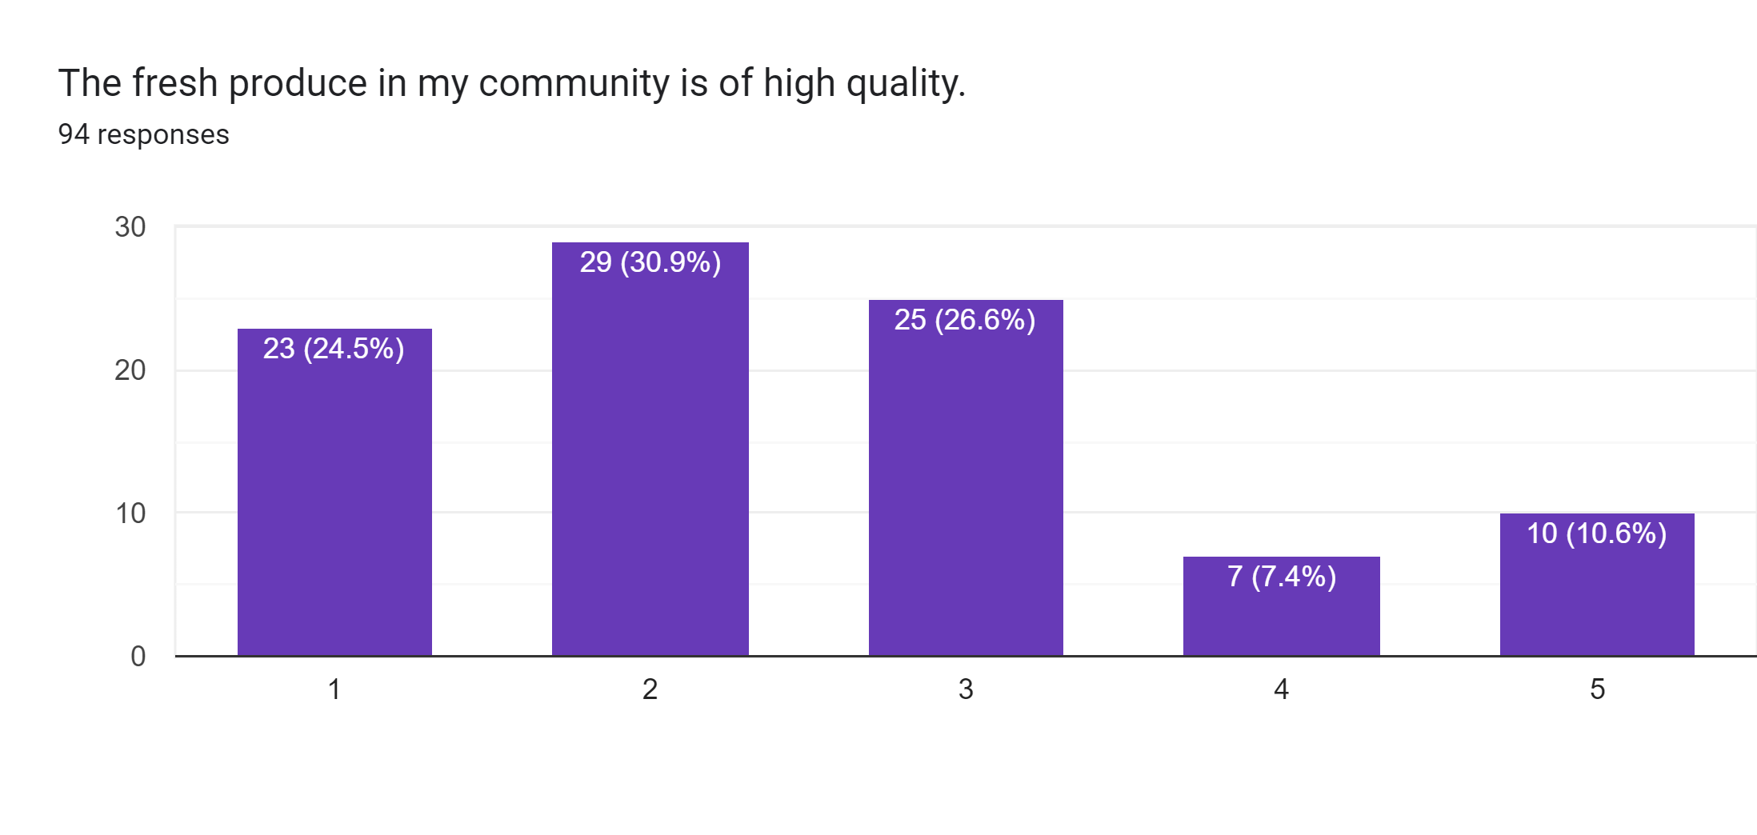
Quality Concerns
Participants also discussed the challenges they faced in getting what they wanted in terms of quality, especially as it relates to fresh fruits and vegetables. This was especially stark during the off season for full year residents.
“local store prices too high and produce quality is not great”
“When we are in the Adirondacks, we typically bring most of our food with us from our primary home. We find it easier to shop there, particularly for fresh foods. We do frequent the farmers market and farm stands in and around old Forge, but make an effort to use the local grocery stores only when we absolutely need some thing.”
1 – Strongly Disagree 5 – Strongly Agree

Slide 14
Seasonality/Winter
A unique aspect of this study population is their geographic location, which is an incredible tourist draw during the summer months. During the winter months, harsh conditions make travel to grocery stores even more difficult, as well as suppliers delivering food to retailers and restaurants.
“The lack of a year-round grocery store nearby makes it very difficult. We drive 70 miles for a grocery store with good produce in the winter, and fill in with one of the smaller stores (all 30 miles away). We also are starting to rely on HelloFresh and other delivered food, which is expensive and not great quality, but convenient and saves on gas costs.”
“summer time and into the fall - no problem, winter into spring - can be problematic. old veggies, so got to use it fast. canned goods are real pricy here”

Slide 15
Cost
While there were many different factors that people cited in their struggles to get the food their family needs, cost was a factor for some. Looking at the respondents who discussed cost being prohibitive, they were mostly talking about the local grocery stores. In the open-ended questions, many wrote that the costs of foods were prohibitive at local grocery stores. This was discussed by people who shopped there regularly, and those who decided to drive to Utica to stock up at large chain stores that have more competitive pricing.
“Driving to Utica every week for affordable, fresh, quality food, fresh produce is hard to come by in town, select few options at the local store in old forge.”

Slide 16
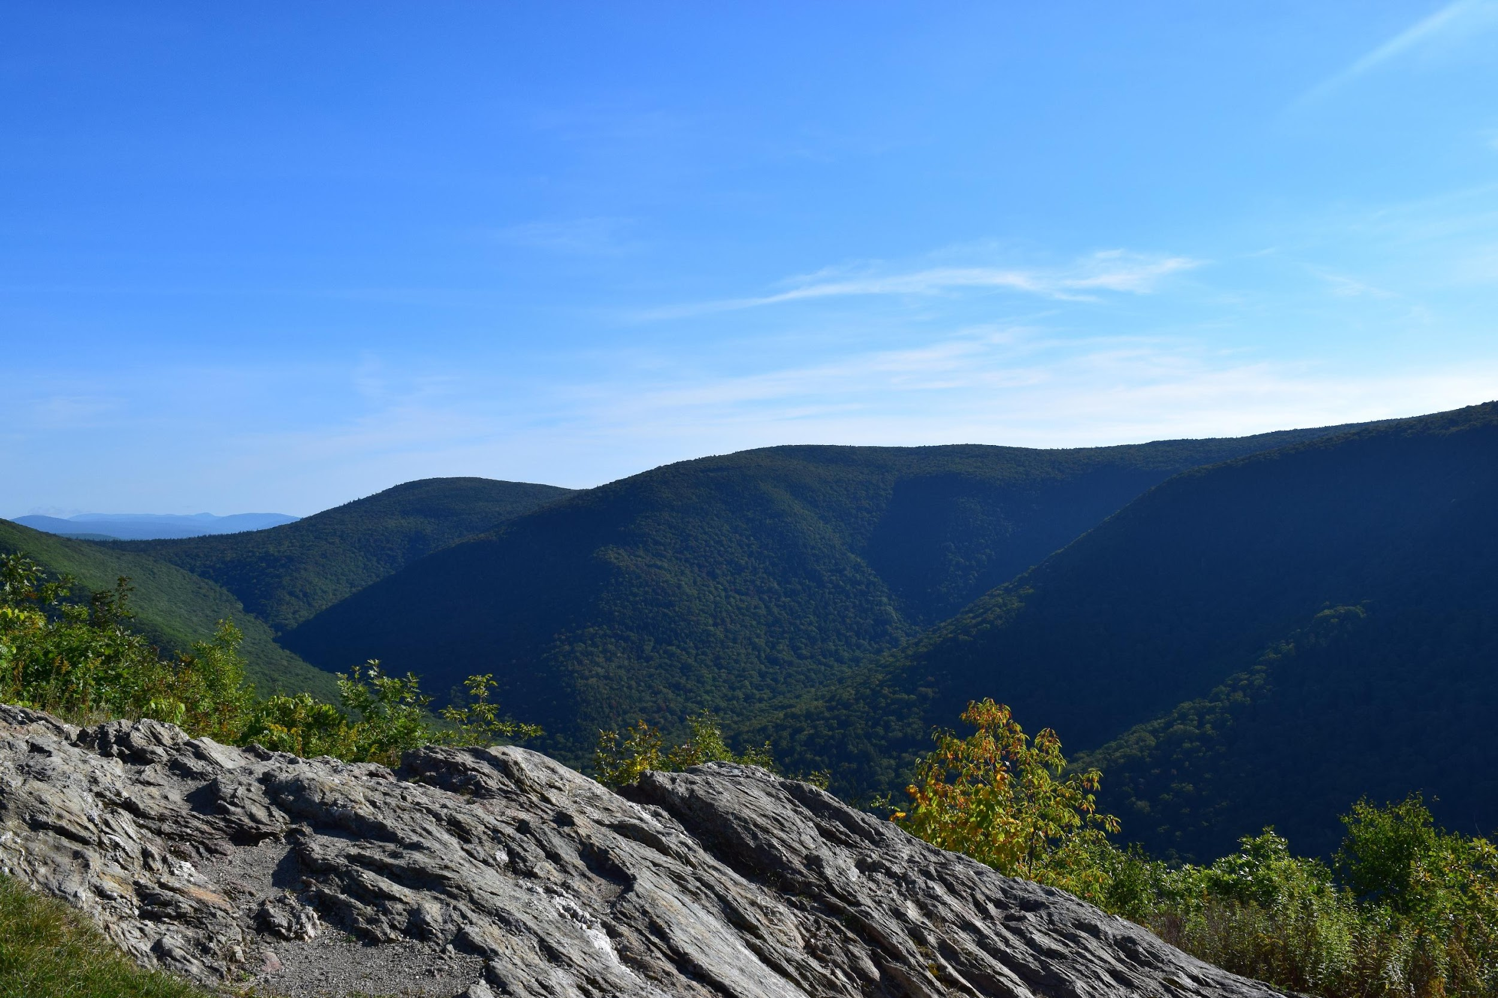
What does this mean?
Residents and tourists alike are leaving the area to buy food, traveling far distances to find fresh, quality produce at a reasonable price.
Respondents rated quality and freshness as the most important quality of the food the look for, with nutrition a close second. Cost and convenience were not as important, which are great indicators when thinking about local solutions and what respondents want.

Slide 17
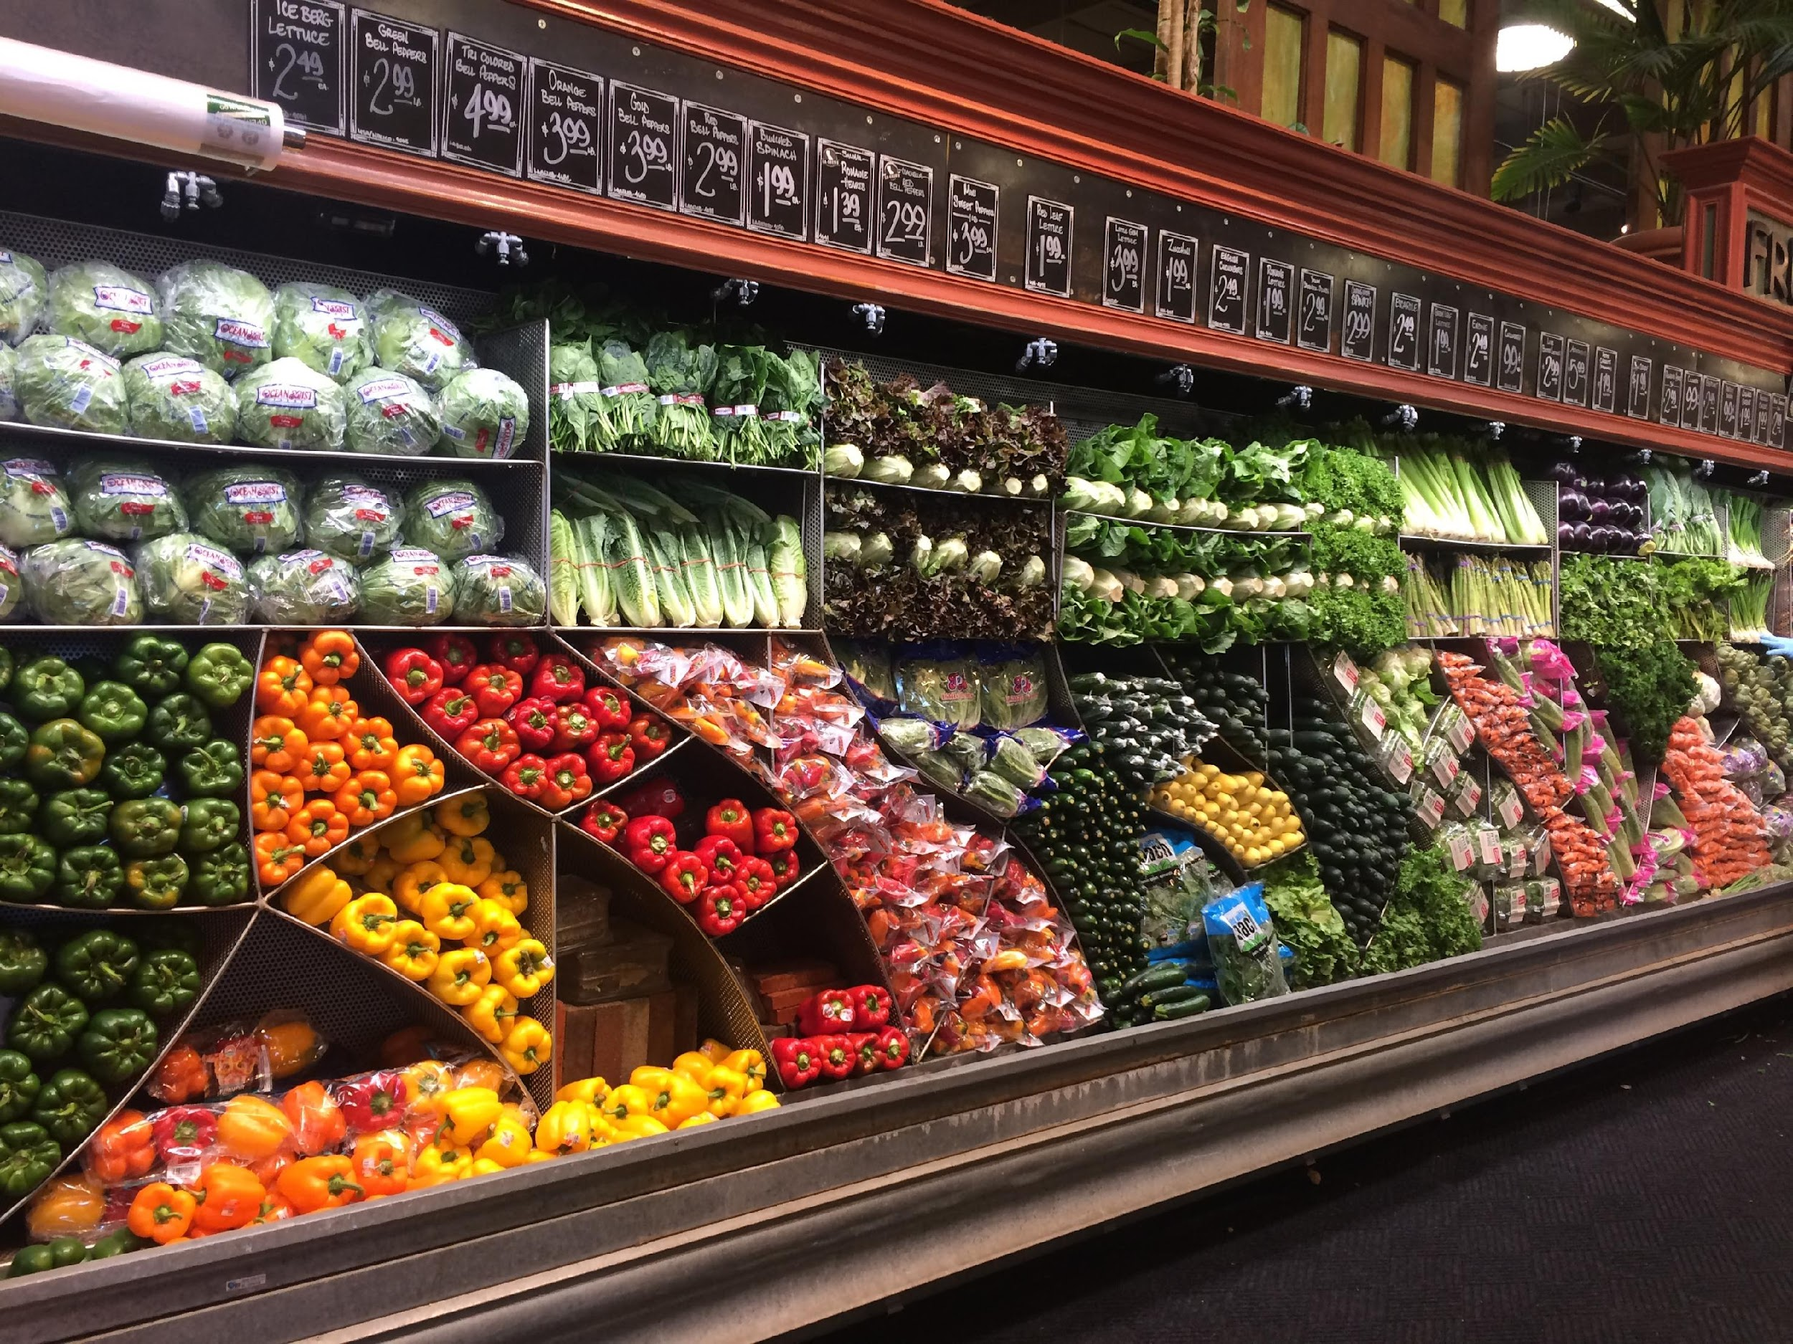
Interviews
We spoke with local grocery store owners and farmer’s that travel to the Old Forge farmer’s market and deliver CSA boxes to Old Forge.
The main barrier for everyone was distribution networks.
Farmer’s were not making enough of a profit/have a big enough customer base to travel the long distance. Marketing efforts to expand their customers have been unsuccessful.
Local grocery store owners rely on corporate distribution networks that do not have local products, because that is what is most efficient and affordable.

Slide 18
Interviews
Grocery store owners valued local food and expressed interest in buying more.
They also told us about past efforts to bring in more local produce and it falling flat because of supply, distribution, and consistency.
They expressed that they are doing whatever they can to keep the food on the shelves during this busy time and would welcome more local produce, but do not have the time, knowledge, or capacity to make it happen. They have a consistent supply and routine with their distributors and that is what they do.
Small local producers are not able to provide the same size and delivery options as the corporate suppliers, and are not able to package the food in the way the grocery stores need to be able to sell how they normally do.

Slide 19
Research Question and Goals
What are the food sources that people are accessing in this Central Adirondack Regional Corridor (CARC) region?
What barriers do residents face in obtaining the food they need to live healthy, happy lives?
Is there an effective local solution that we can help promote to address some of this?
How can we strengthen local supply chains to increase access (by partnering with Mohawk Valley producers, farmers, and other organizations throughout the Adirondack Region working on similar initiatives)?

Slide 20
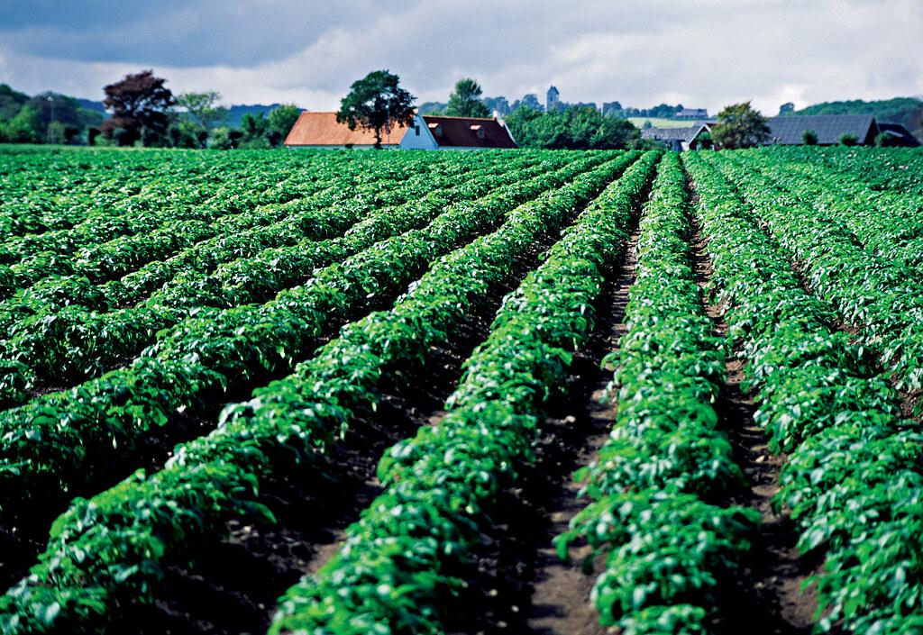

Discussion
70% of respondents buy most of their food from the grocery store.
78% of respondents said they would be more likely to buy local vegetables and fruits if they were available at the grocery store
The grocery store owners told us that when they do have local products, they sell out even though they are priced at a premium
Farmer’s have produce to sell and do come to the farmer’s market weekly
Grocery store owners want local, better produce

Slide 21
Conclusion
There are customers willing to pay a premium in this market, especially in the summer. This variable supply/demand is a challenge and an asset.
Both grocery store owners and farmer’s have an interest in expanding the market.
Current distribution efforts are not working
Next steps:
  speak with restaurant owners to create a larger market for local producers
  event to bring together stakeholders from stores, farms, consumers

